Slide 1
IDO-IT BY TOMORROW
You need it, IDO-IT

Slide 2



Young start-up created in 2012
4 Students from UPMC University
Based in Paris
Our goal : make your daily life easier

Slide 3
I DO-IT
Main features :
Cleaning
Central heating and air conditioning control
Alarm clock
Communicates with connected devices in the house : fridge, washing machine… Makes your shopping list and orders your daily supplies on the internet.

Slide 4
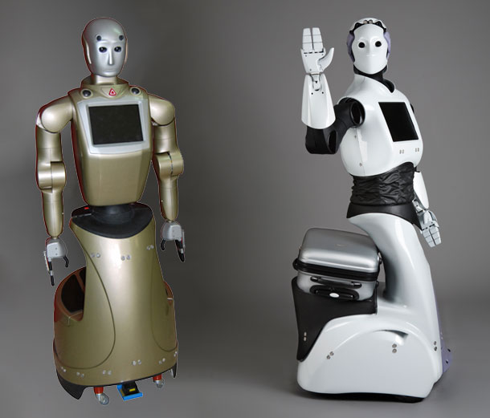
Two models
IDO-IT Premium : pre orders for the CIIC at 9999 €
Humanoid shape + additionnal features :
Looks after your house : detectors at windows, doors. Texts you with reports at pre-set hours, takes pictures if it detects someone and alerts the police
Washes dishes, cooks thanks to French deep learning algorithms.
Personal assistant & language comprehension : 3 languages processed: French, English & Chinese (passed the Turing test)
Babysitting.
Health assistant : connected to your watch to detect your health figures (blood pressure, temperature) and can call a doctor if needed
A service for elderly people : can help opening doors, bringing objects
Handle itself its battery

Slide 5
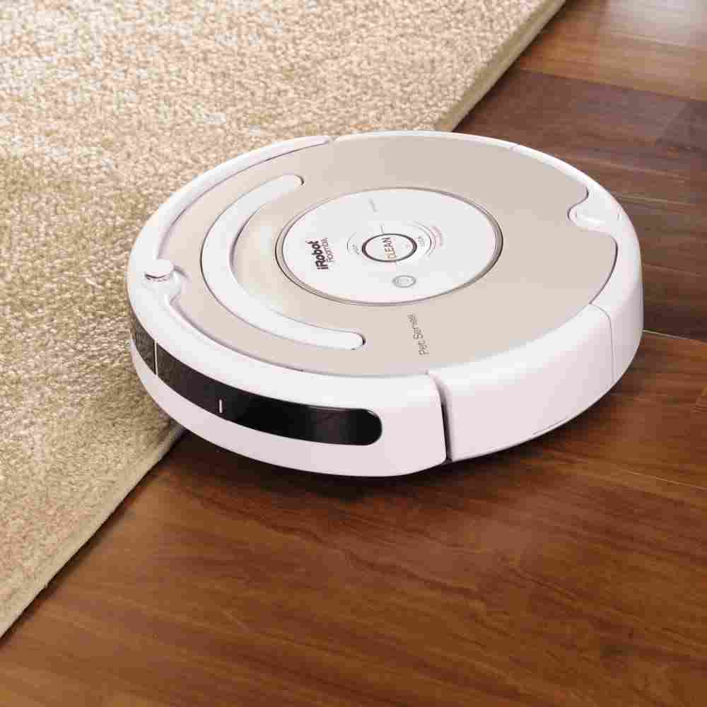
IDO-It Basic : 1499€
Health features included
Longer battery life
Small size, portable
Stairs are not handled
But for 399€ we provide an install
equipements so IDO-it covers all the house.

Slide 6

A Green and Ethical Robot
100% made of recycled materials
Green management of energy
Garantee privacy : No digital trails and high privacy sets up
Apps Platform for Developers to extend possibilities
Waste management

